Slide 1
Machine Learning with Code
Logistic Regression
Support Vector Machine
Random Forest

Slide 2
Principles behind Logistic Regression
Logistic regression is a statistics technique for binary classification.
Used to model the probability of a certain class or event existing such as pass/fail, win/lose, alive/dead or healthy/sick.

Slide 3
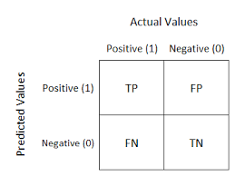
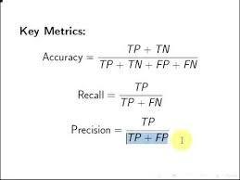
Confusion Matrix
A confusion matrix is a table that is often used to describe the performance of a classification model (or "classifier") on a set of test data for which the true values are known.

Slide 4
Assumptions behind Logistic Regression
The dependent variable should be dichotomous in nature (e.g., presence vs. absent).
There should be no outliers in the data, which can be assessed by converting the continuous predictors to standardized scores.
There should be no high correlations (multicollinearity) among the predictors.

Slide 5
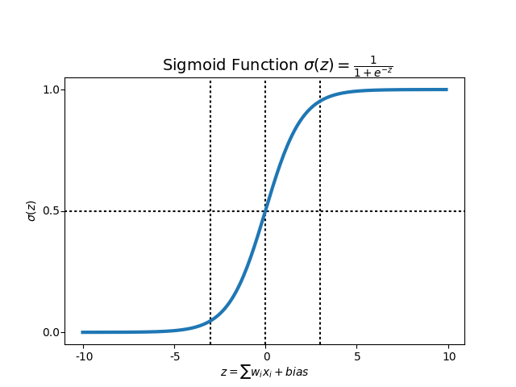
Mathematical Function behind Logistic Regression

Slide 6
Data
https://www.kaggle.com/c/titanic/data

Slide 7
Code
https://github.com/Aninditasg/Aicamp-ML-Logistic-Regression/Logistic Regression.ipynb

Slide 8
Support Vector Machines
SVM is a supervvised classification algorithm used in a variety of applications such as face detection, intrusion detection, classification of emails, news articles and web pages, classification of genes, and handwriting recognition
The classifier separates data points using a hyperplane with the largest amount of margin.
SVM finds an optimal hyperplane which helps in classifying new data points..

Slide 9
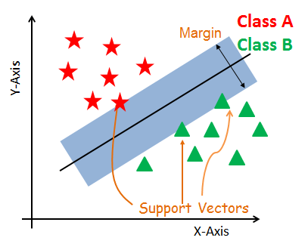
Classification of different Objects

Slide 10
Keywords
Support Vectors
Support vectors are the data points, which are closest to the hyperplane. These points will define the separating line better by calculating margins. These points are more relevant to the construction of the classifier.
Hyperplane
A hyperplane is a decision plane which separates between a set of objects having different class memberships.
Margin
A margin is a gap between the two lines on the closest class points. This is calculated as the perpendicular distance from the line to support vectors or closest points. If the margin is larger in between the classes, then it is considered a good margin, a smaller margin is a bad margin.

Slide 11
How does it work?
The main objective is to segregate the given dataset in the best possible way. The distance between the either nearest points is known as the margin. The objective is to select a hyperplane with the maximum possible margin between support vectors in the given dataset. SVM searches for the maximum marginal hyperplane in the following steps:
Generate hyperplanes which segregates the classes in the best way
Select the hyperplane with the maximum segregation from the either nearest data points.

Slide 12
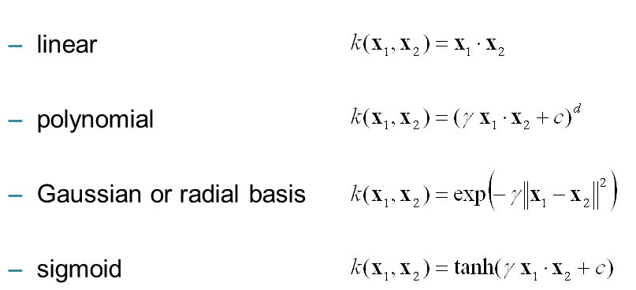
Common SVM Kernels

Slide 13
Code Repository
https://github.com/Aninditasg/AICAMP-ML-SVM-
Data
https://github.com/Aninditasg/AICAMP-ML-SVM-/Data
https://www.kaggle.com/neiljs/all-shark-tank-us-pitches-deals/downloads/Sharktankpitchesdeals.csv/2

Slide 14
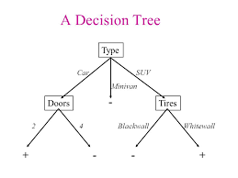
Decision Tree
A decision tree analyses a data set in order to construct a set of rules, or questions, which are used to predict a class.
These rules can be built up to create a model that can classify complex situations.

Slide 15
Random Forest
There are two fundamental ideas behind a random forest, both of which are well known to us in our daily life:
Constructing a flowchart of questions and answers leading to a decision
The wisdom of the (random and diverse) crowd
The fundamental idea behind a random forest is to combine many decision trees into a single model. Individually, predictions made by decision trees (or humans) may not be accurate, but combined together, the predictions will be closer to the mark on average.
Why the name ‘random forest?’ each decision tree in the forest considers a random subset of features when forming questions and only has access to a random set of the training data points.

Slide 16
Prediction in Random Forest
When it comes time to make a prediction, the random forest takes an average of all the individual decision tree estimates for regression problems like predicting the temperature on a day of the week.
For classification problems, where the targets are a discrete class label such as cloudy or sunny, the random forest will take a majority vote for the predicted class.

Slide 17
Code Repo
https://github.com/Aninditasg/AICAMP-ML-Random-Forest
Data :
https://github.com/Aninditasg/AICAMP-ML-Random-Forest/Data

Slide 18
Applications of the discussed Algorithms
Credit Scoring (SVM and Random Forest)
Spam Filtering(Random Forest)
Fraud Detection(Random Forest)
Trauma and Injury Severity Score (TRISS) was built using logistic regression.
Customer profiling using logistic regression.

